Slide 1





Grow Mate
Your agricultural partner
Crop and fertilizer recommendation along with disease
identification and prescribed supplements
Team Members
Guide
1. Sankit Binkar
2. Harshal Borkar
3. Nayana Pardhekar
4. Harsh Gathode
5. Aditya Mate
Akshay Chaskar

Slide 2
Disclaimer
The content is curated from online/offline resources and used for educational purpose only

Slide 3

Course Outline
Abstract
Problem Statement
Aims, Objective & Proposed System/Solution
System Design/Architecture
System Development Approach (Technology Used)
Algorithm & Deployment
Future Scope
Conclusion
References
Notes:
These are the list of chapters that we are going to cover in these foundation codes. Those are chapter one what are AI and ML? chapter 2 applied Python programming in AI, and chapter 3 is exploratory data analysis for ML.

Slide 4


Abstract
This project focuses on developing a machine learning-based crop recommendation system to assist farmers in optimizing their crop selection. The system takes input parameters such as nitrogen, phosphorus, potassium levels, temperature, ph of soil , rainfall and humidity. The algorithm analyzes these factors to recommend the most suitable crop for cultivation. We have compared multiple ML algorithms and got RandomForestclassifier as best option. It also recommends best fertilizer for the crop along with a brief description about it. The proposed system aims to enhance agricultural decision-making, promote sustainable farming practices, and ultimately contribute to improved crop yield and resource utilization.

Slide 5


Problem Statement
Farmers face challenges in optimizing crop selection to maximize yield while efficiently utilizing resources. Existing methods often lack precision and fail to account for various environmental factors. This project addresses the gap by proposing a machine learning-based crop and fertilizer recommendation system. It is also difficult to identify Disease and it's cure. Its' also difficult to find expert help for this.

Slide 6

Aim and Objective
Aim: To revolutionize the agricultural landscape by providing a online platform that empowers farmers with cutting-edge information and tools. Our aim is to encourage sustainable farming practices, bridge the gap between traditional and innovative methodologies, and cultivate a thriving community that embraces technology for the betterment of agriculture.
Objectives:
Precise Agriculture Guidance
Integrated Disease Management
Showcasing New Cultivation Techniques & Technologies
Government Scheme & Subsidies Information
Continuous Improvement and Innovation
Sustainable Agriculture Advocacy
User-Friendly Platform

Slide 7
Proposed Solution
Empowering Agriculture for a Sustainable Future
1
2
3
Advanced recommendation system
Intelligent disease detection
Latest cultivation technologies.
4
5
Repository of government schemes and subsidies.
Promote sustainable agricultural practices

Slide 8
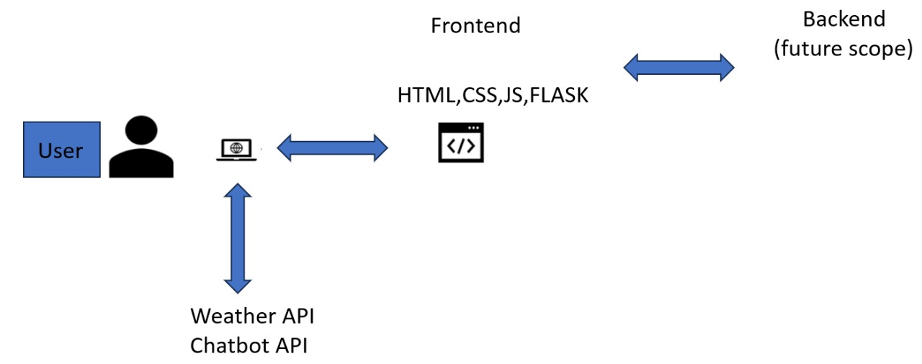
System Architecture

Slide 9
System Deployment Approach
Crop Recommendation:
Found Random Forest Classifier as best
Accuracy: 99.5%
Dataset Collection and Preprocessing
Compare different algorithm
Finding Insights
Model Building
Developed web application using flask along with API integration
Disease Identifier:
Dataset Collection and Preprocessing
MobileNetV2 Algorithm used
Model Building
Found accuracy of 98.24%

Slide 10
Algorithm & Deployment
Random Forest Classifier
Mobile Net V2 – CNN Algorithm
Weather API
OpenAI API

Slide 11

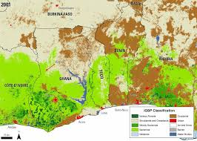
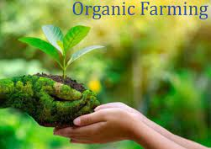

Future Scope
Include land type for predicting best crop.
Focusing more on organic farming methods with new cultivation techniques.
Access to Government schemes and subsidies easily.
Database Integration

Slide 12

Conclusion
GrowMate: Machine Learning based system provides a robust and data-driven approach for farmers to make informed decisions, fostering sustainable agriculture practices and optimizing crop yield in varying environmental conditions. This tool contributes to the modernization of farming strategies.
Notes:
12

Slide 13
Reference
M. Patel, A. Rane, and V. Patni, "Crop Recommendation System using Machine Learning", 2021, doi: 10.31224/2959.
Pradeepa Bandara, Thilini Weerasooriya, Ruchirawya T.H., W.J.M. Nanayakkara, Dimantha M.A.C, Pab sarana M.G.P., "Crop Recommendation System", on ResearchGate, 2020 [Online].
Dhruvi Gosai, Chintal Raval, Rikin Nayak, Hardik Jayswal, and Axat Patel, "Crop Recommendation System using Machine Learning", International Journal of Scientific Research in Computer Science, Engineering and Information Technology (IJSRCSEIT), vol. 8, no. 5, pp. 129-133, 2021.
Notes:
Reference
These are the references for this session.

Slide 14
Thank you!
Notes:
Thank you very much for joining this PPT, keep learning.
14

